Slide 1
EMCH 308 Project 1
By Tristan Guérin, Jacob Vaught, Rafael Alexander Sánchez Cid, & Jacob Whisenant

Slide 2
Introduction
Objective: Determine best beam profile for smallest cross section area for loaded truss
Cross sections tested: I-Beam, T-Beam, Circle-Beam, & Box-beam

Slide 3
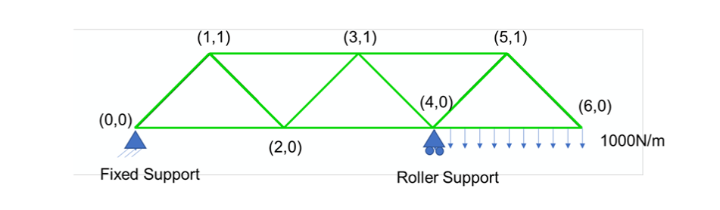
Introduction Cont.
Young’s Modulus: 200 GPa
Poison’s Ratio: 0.3
Failure Stress: 400 MPa
Safety Factor: 1.5
Safety Factor Max Stress: 266 MPa

Slide 4
Approach
Create a 2D planar deformable planar wire sketch
Create a material
Create Profile
Create section and assign the section
Create and instance
Create new step
Mesh the part
Create boundary conditions and the line load
Run the job file
Review results
Repeat steps 3, 9, & 10 until the max stress is achieved

Slide 5
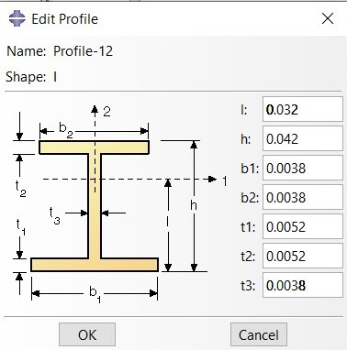
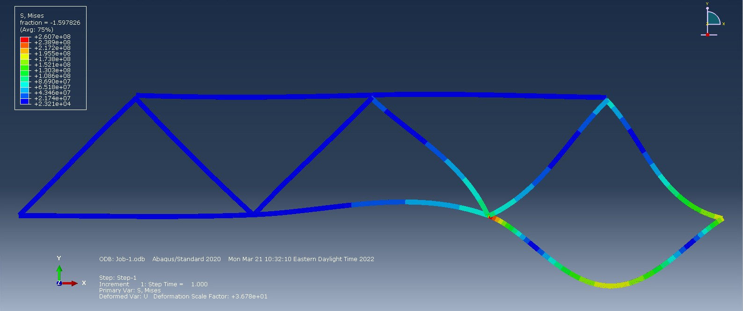


I-Beam Tested by: Tristan Guérin
Area: ${1.596∗10}^{−4}$ $m^{2}$ = 159.6 ${mm}^{2}$
Max Stress: 2.607x${10}^{8}$ Pa = 260.7 MPa

Slide 6
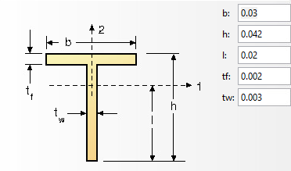
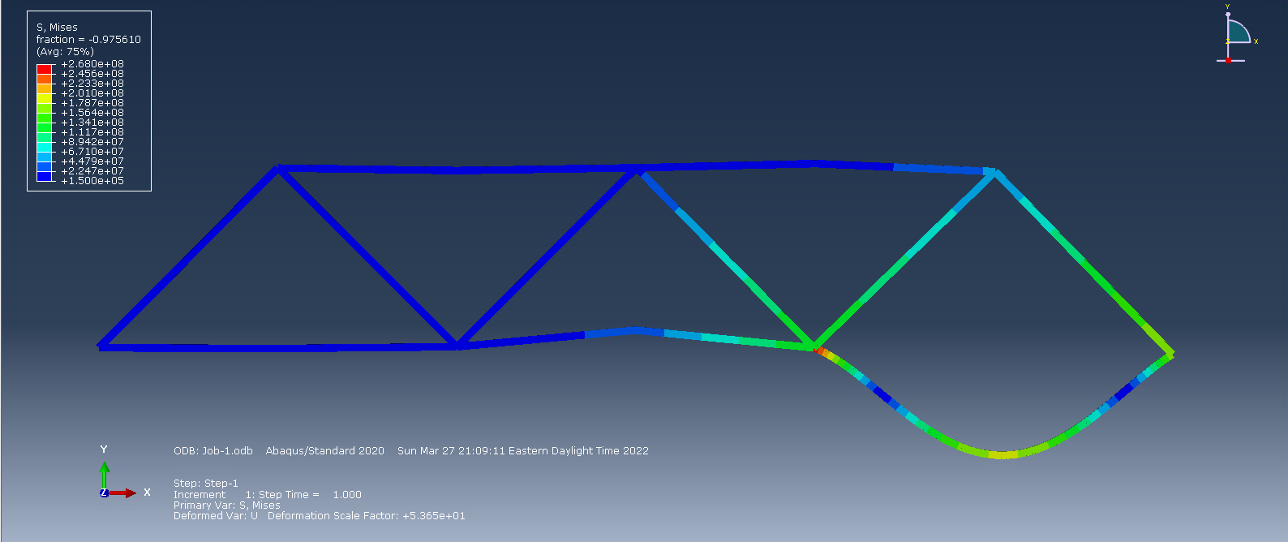


T-Beam Tested by: Rafael Alexander Sánchez Cid
Area: 1.8x${10}^{−4}$ $m^{2}$ = 1$80{ mm}^{2}$
Max Stress: 2.68x${10}^{8}$ Pa = 268 MPa

Slide 7
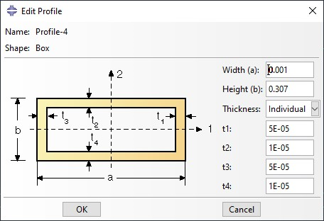
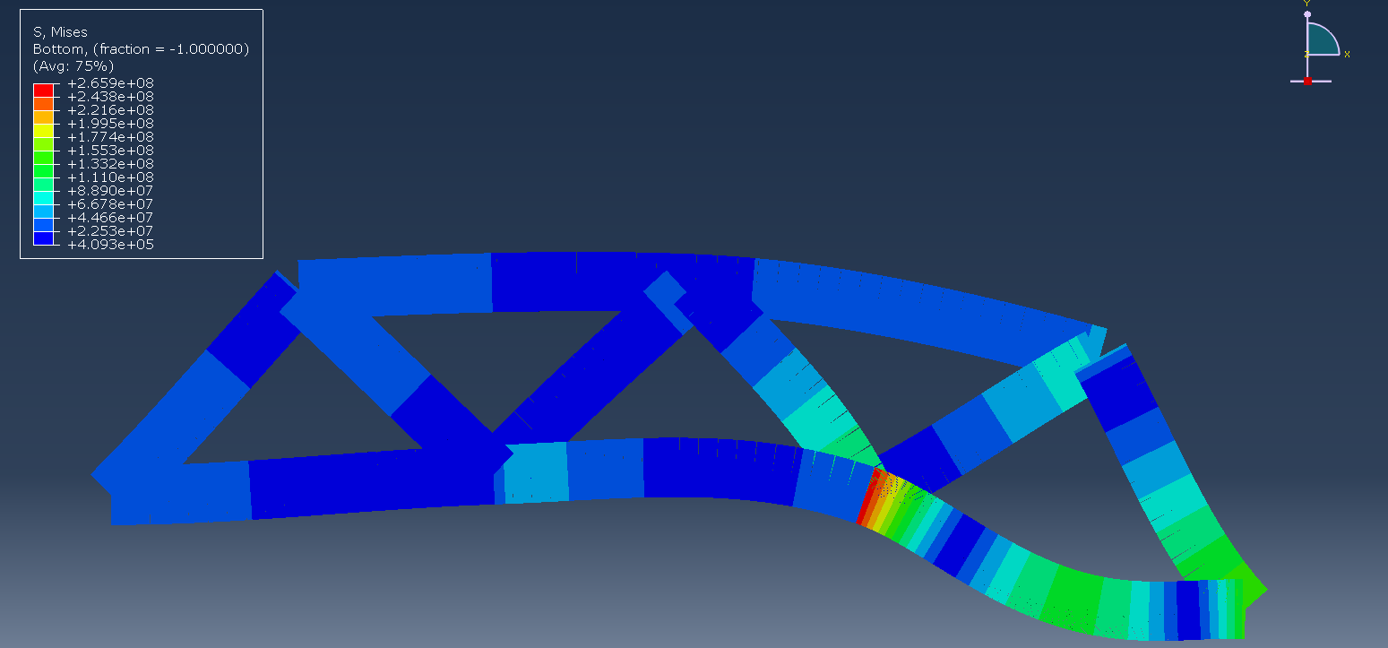

Box-Beam Tested by: Jacob Vaught
Area: 3.072x${10}^{−5}$ $m^{2}$ = 30.718 ${mm}^{2}$
Max Stress: 2.659x${10}^{8}$ Pa = 265.9 MPa

Slide 8
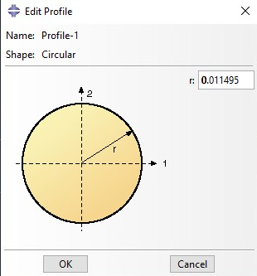
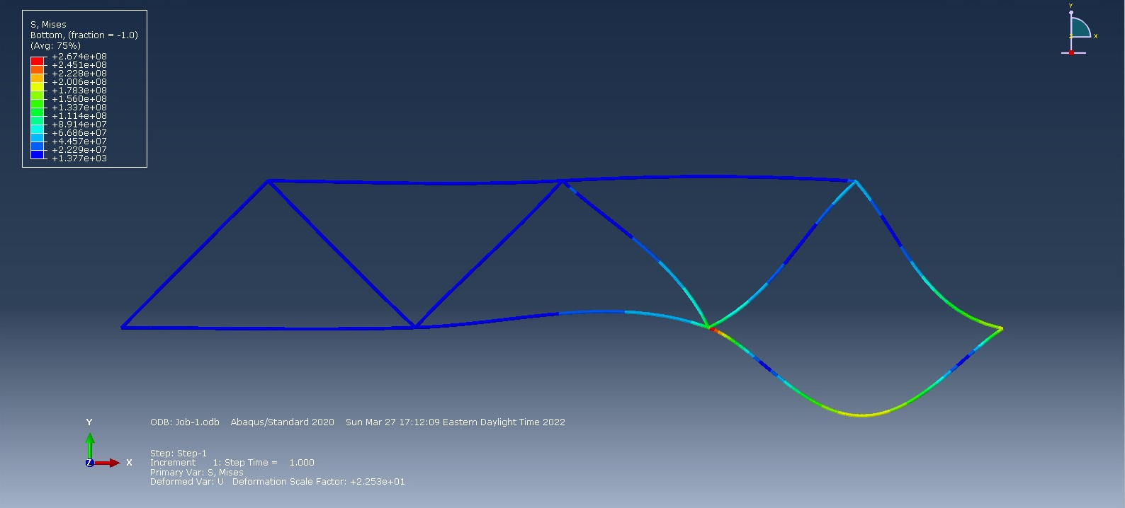


Circle-Beam Tested by: Jacob Whisenant
Area: 4.151x${10}^{−4}$ $m^{2}$ = 415.1 ${mm}^{2}$
Max Stress: 2.66x${10}^{8}$ Pa = 266 MPa

Slide 9
Conclusion
Most efficient cross section:
Rectangular cross section
Why:
The Box Profile had the smallest cross-sectional area and the T, and I beams converge on rectangular shape

Slide 10
Thank You!
Any Questions?

